Slide 1

Data Visualization Lab Project
Project 2026
E-Commerce Sales
Dashbaord Presentation
Presented By :
Sanaullah Tareen, M. Mansoor Khan and Aitsam Zulfiqar

Slide 2
Agenda
Presentation
Overview
01
07
Title Slide
Data Visualization and dashboard
02
08
Problem Statement
Results and Findings
03
09
Objectives
Business Impacts and Recommendations
04
10
Dataset Overview
Tools and Technologies
05
11
Data Cleaning & Processing
Challenge Faced & Technologies
06
12
Methadology
Conclusion

Slide 3
Problem Statement
High Return Rates
Unclear Profit Drivers
5.5% of all orders are returned. Without understanding why, the business keeps losing revenue on refunds, restocking, and lost customer trust.
Sales are $6M but what drives profit? Which products, regions, and customer segments are actually profitable vs. drain resources?
What Business Problem Are We Solving?
Delivery & Satisfaction
No Targeted Strategy
Is late delivery causing returns? The relationship between delivery time and return rate was unknown and untracked.
Without data-driven insights, marketing spend, inventory decisions, and regional strategies were made on guesswork rather than evidence.

Slide 4
Objectives
What This Project Aims
to Achieve
Data
E-Commerce
1
2
3
Identify the top reasons customers return products and reduce the return rate by understanding root causes.
Analyze sales and profit trends across months, regions, and product categories to find growth opportunities.
Investigate whether late delivery leads to higher return rates — and quantify the impact.
4
5
Understand which customer segments (by age, gender, region) generate the most revenue.
Build interactive Power BI dashboards for executives and managers to make faster, data-driven decisions.

Slide 5


Dataset Overview
Dataset Summary
Key Columns
E-COMMERCE DATA
Total Orders:
34,956
Total Customers:
Multiple Segments
Region:
North, East, West, South & Central
Categories:
7 (Fashion, Home, Electronics........)
Year Covered:
2023-2024-2025
Return Numbers:
1902 Records
Payment Method:
6 Different
Profit Status:
Labeled Profit / Loss
Order_id
Customer_id
Category
Region
total_Revenue
total_profit
delievery_days
return_reason
payment_method
age_group

Slide 6
Data Cleaning & Preprocessing
Removing
Duplicates
Handling Missing
Values
Data Type Correction
Identified and deleted duplicate order_id entries to ensure each transaction was counted once.
Null values in return_reason were filled with 'No Return'. Missing delivery days were imputed using category averages.
Converted date columns to proper DateTime format. Ensured revenue and profit columns were numeric
(not text).
Derived New Columns
Standardized Categories
Outlier Review
Created: age_group (from customer age), YearMonth (from order date), Return Flag (binary 0/1), Profit Status (Profit/Loss).
Normalized text fields — removed trailing spaces, fixed inconsistent spelling in region and category columns.
Reviewed extreme values in delivery_days and total_revenue. Kept valid outliers; removed data entry errors.

Slide 7
Methadology
Data Collection
Analytical Framework & Approach
Data Cleaning
Exploratory Analysis
Steps Involve in Overall Process
Dashboard Design
Insights & Report
Data
E-Commerce

Slide 8
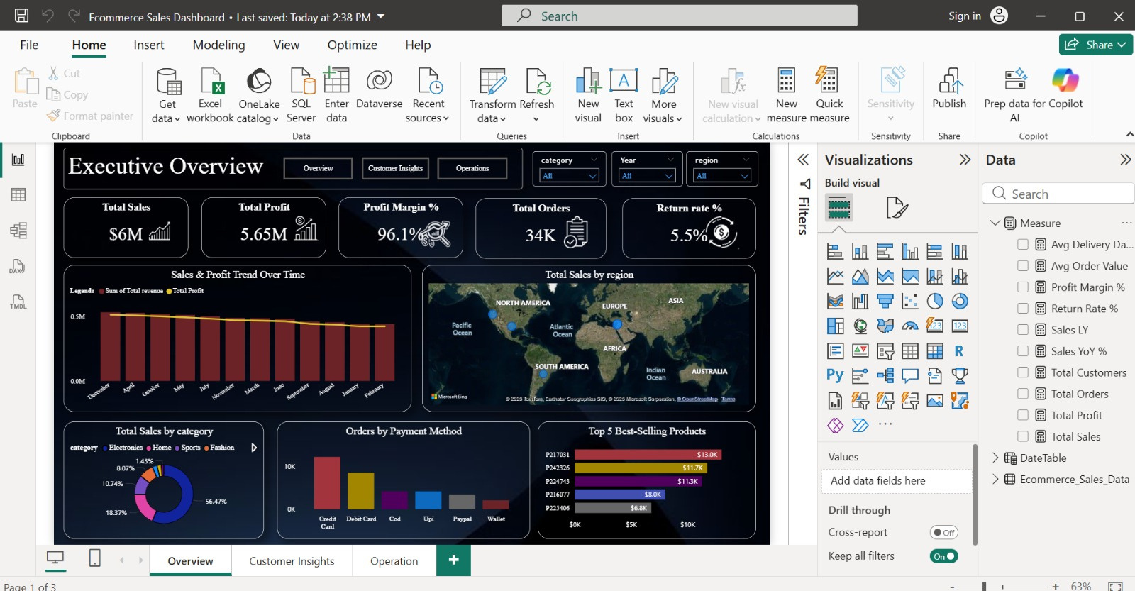
Data Visualization
Presentation
Executive Dashboard

Slide 9
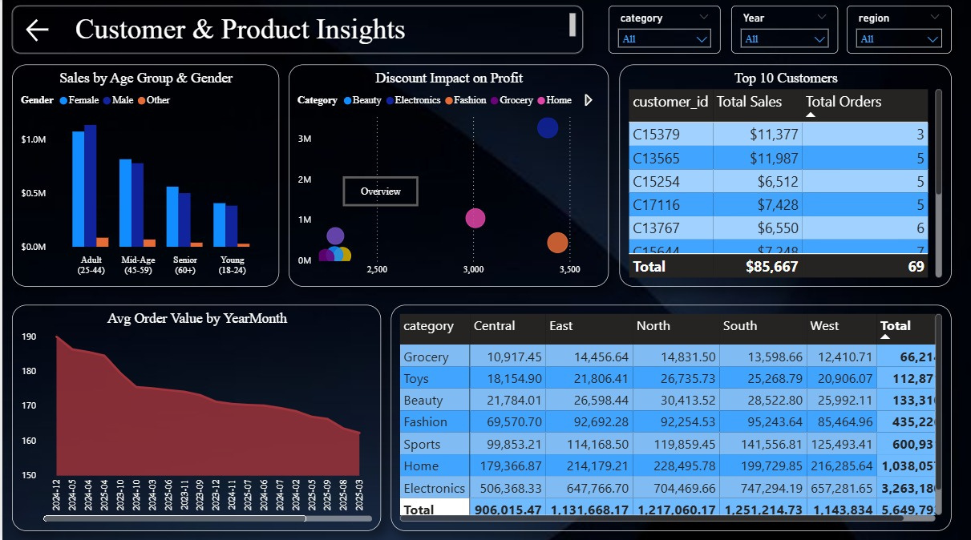
Data Visualization
Presentation
Customer & Product Insights

Slide 10
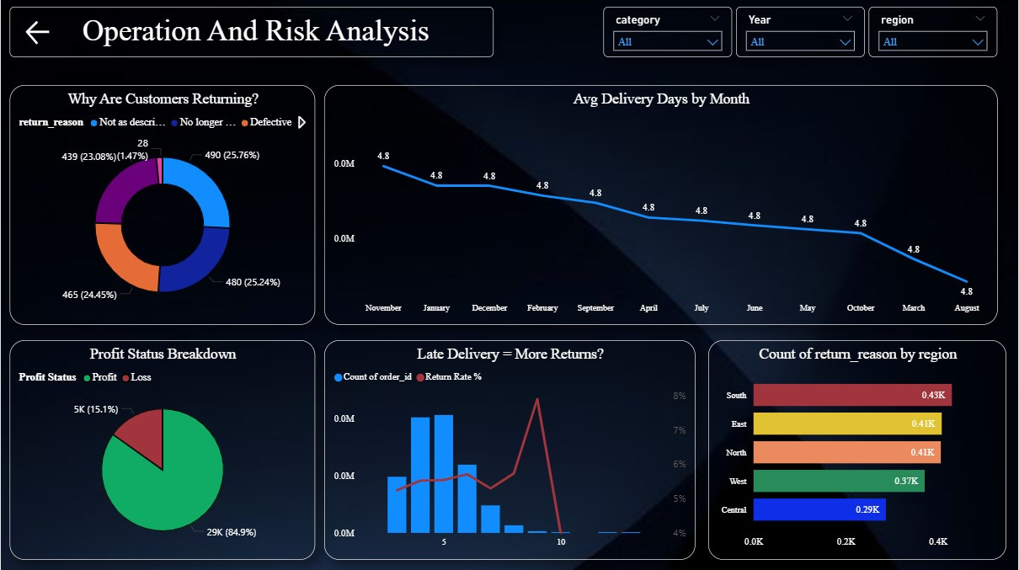
Data Visualization
Presentation
Executive Dashboard

Slide 11
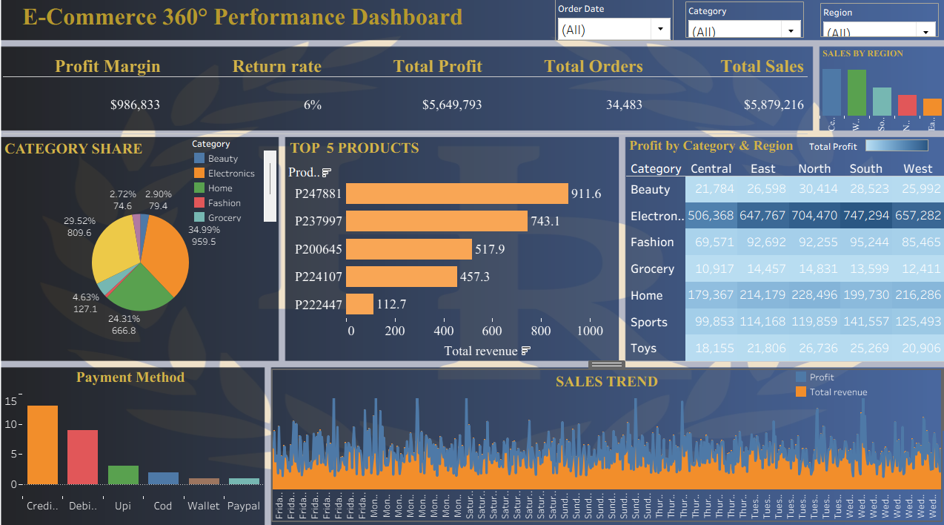
Data Visualization
Presentation
Executive Dashboard
tableau

Slide 12
Results & Key-Finding
Electronics Dominates Sales
Delivery Time: 4.8 Days Average
High Profit Rate:
84.9%
Electronics accounts for 56.47% of all sales ($3.26M), followed by Home at 18.37%. It is the clear revenue driver.
Average delivery is consistent at ~4-8 days across all months. Peak returns occur around 5–6 delivery days.
84.9% of all orders generate profit. Only 15.1% result in a loss — indicating a healthy but improvable margin.
Return Reasons Are Balanced
South & East Lead Returns
Adults Are Top Buyers
The 25–44 age group (Adults) generates the highest sales (~$1M+). Female customers slightly outspend male customers.
Returns are nearly equally split: Not as Described (25.76%), Defective (25.24%), No Longer Needed (24.45%). No single cause dominates.
South region has the highest return count (0.43K), followed closely by East and North (both 0.41K).

Slide 13
Recommendations
Improve product descriptions and images — 25.76% of returns are because the product was 'Not as Described'. Accurate listings directly cut refund costs.
Reduce Returns
Target South Region
South has the highest return count. Investigate supplier or logistics issues in this region. Consider regional promotions to win back customer confidence.
Focus on Electronics
Electronics is 56% of revenue. Prioritize stock availability, quality control, and after-sales support for this category to protect the top revenue driver.
Loyalty for Adults
(25-44)
Adults generate the most sales. Launch loyalty programs, personalized offers, and subscription options targeting this age group.
Delivery Optimization
Maintain or reduce the 4.8-day average delivery time. Offer express options for high-value electronics orders to reduce impatience-driven returns.
Loss-Order Review
15.1% of orders result in loss. Analyze these orders by category and discount level — reduce deep discounts that don't recover costs.

Slide 14

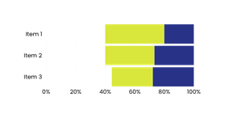

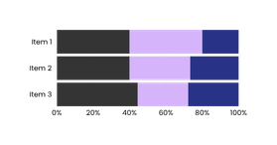
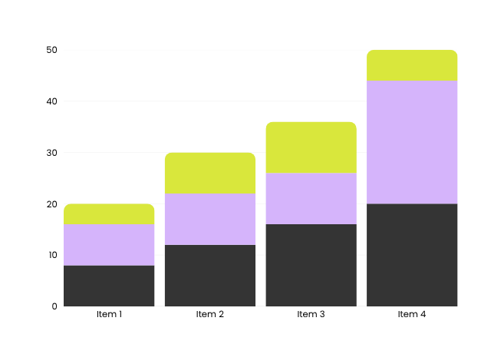
Tools & Technologies
Conversion Rates
Lead Generation
Retention and Upsell
Power Query (M)
Data Transformation
DAX (Data Analysis)
Calculate the Measure
Fields
SQL Query Language

Slide 15
Challenges Faced
Inconsistent Data Quality
Challenge: Raw data had missing values, mixed date formats, and inconsistent category names.
Solution: Power Query was used to standardize text, fill missing values with defaults, and parse dates correctly.
Creating Accurate DAX Measures
Challenge: Calculating return rate, delivery averages, and profit margins required complex DAX formulas..
Solution: Search through many of the documentations and other resources to understand POWER BI formulas.
Data Relationships & Model Design
Challenge: Linking multiple tables (orders, returns, customers) required a correct star-schema model.
Solution: Designed a fact-dimension model with clear one-to-many relationships and avoided circular dependencies.

Slide 16
Conclusion
Presentation
01
Built 3 fully interactive Power BI dashboards covering executive overview, customer insights, and returns analysis.
02
Identified Electronics as the dominant revenue driver at 56.47% of total sales ($3.26M of $6M).
03
Discovered that return reasons are almost evenly distributed — no single fix will solve everything; a multi-pronged approach is needed.
04
Found that delivery time averages 4.8 days and correlates with return spikes at 5–6 days.
05
Revealed that 84.9% of orders are profitable — validating business health while identifying the 15.1% loss orders for review.
06
Provided 6 actionable business recommendations backed by data visualization.

